Slide 1
PetS
Group members -
Vanam Hemanth
Neelakanta Sriram
Dupally Nikhil
Setty Venkat Vishwanth
B.Devender naik

Slide 2
Introduction
A social platform to share pets cute moments and manage their pets like daily schedule, food habits, online food store, veterinarian, accessories, babysitting for pets, adoption of animals.

Slide 3
Motivation
To create a shelter for street animals.
To bring awareness to pet lovers on how to take care of their pets.
To provide babysitting service etc

Slide 4
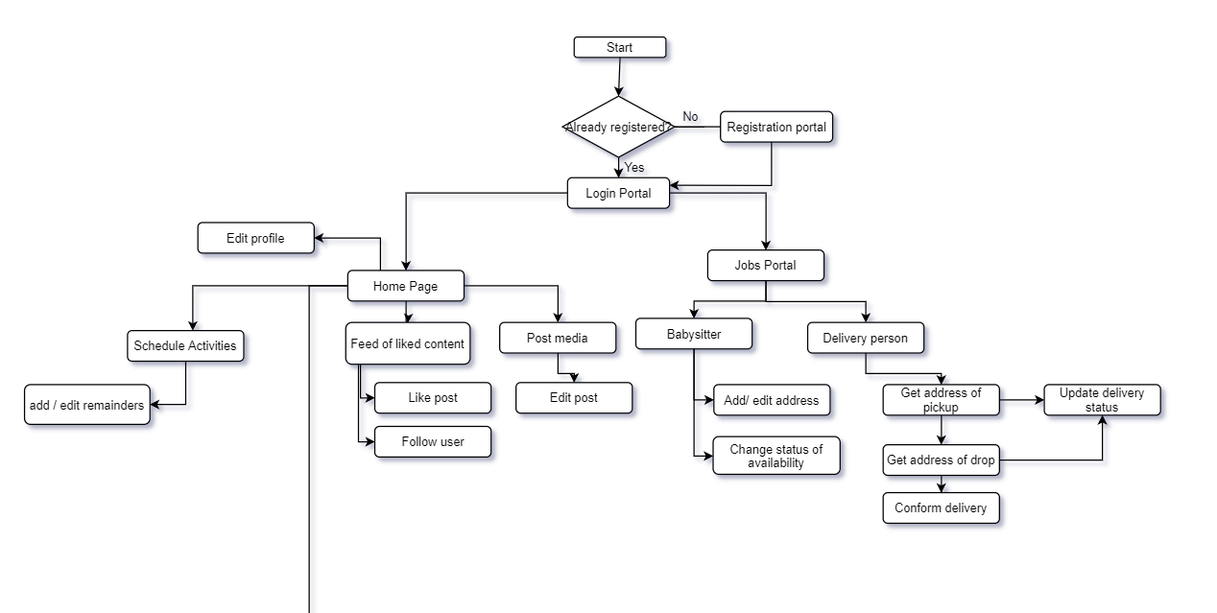

Slide 5
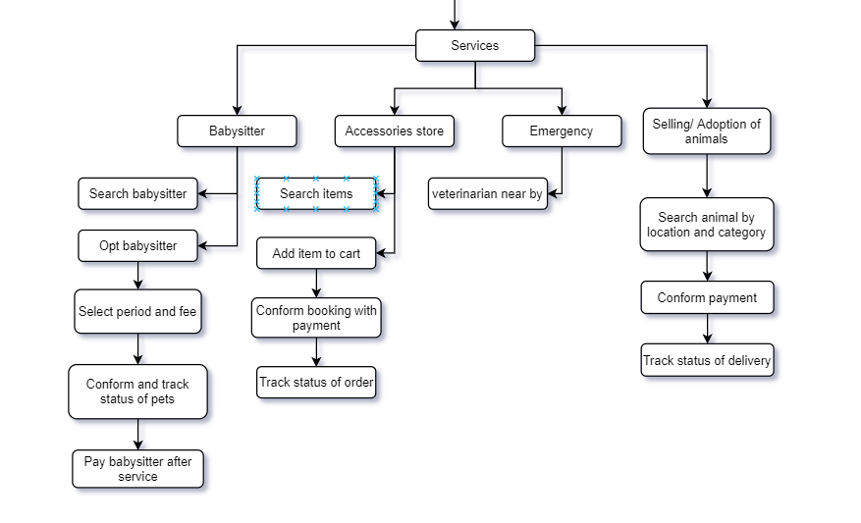

Slide 6
Module - 1
Social Media Platform:
Create, edit user
Posting photos
Like, Share, Follow other users

Slide 7
Module -2
Authentication
User Management
Flutter UI
Firebase Notification System

Slide 8
Module - 3
Accessories selling:
Selling of accessories for pets like food, clothes, collar belts etc.
Payment system for online transactions.
Delivery service.

Slide 9
Module-4
Delivery Tracking
Finding Best route for delivery

Slide 10
Module -5
Selling pets and adoption:
Portal for selling pets, or adoption of street animals.
Payment portal for transactions.

Slide 11
Module - 6
Veterinarian doctor near by:
Suggest the veterinarian doctor clinic using the location of the user.
Google maps api

Slide 12
Module - 7
Babysitting Service:
Portal for opting for babysitting of pets.
Payments for babysitters

Slide 13
Module - 8
Classification of pets
Using CV to classify the different pets and show feed with the user interest.
To get interests of the user by his or her activities and showing best interest contents.

Slide 14
Module - 9
Scheduling of activities:
Setting reminders for feeding food(push notifications)

Slide 15
Integration
Implementing module 1 - 4 till the end of february.
Implement module 5 - 8 till the end of april.
Github for easy integration.
Circle CL for testing while integration.

Slide 16
Module - 10
Integration, testing and deployment:
Integration of all modules.
Implementing testing for all modules.
Deploying the app to one of the online web services like AWS, DigitalOcean, GCP etc

Slide 17
Deployment
Using github to store our code base and easy to integrate.
We plan to deploy our backend to any cloud hosting services which can be easily integrated with github.

Slide 18
Tech Stack
Backend: NodeJS
DataBase: FireStore (Firebase database)
User Interface: Flutter App, Flutter Web
Testing: CircleCI
Hosting: GCP/ AWS/ DigitalOcean
ML : Keras, Tensorflow

